Slide 1



chapter 6
HCI in the software process

Slide 2
HCI in the software process
Software engineering and the design process for interactive systems
Usability engineering
Iterative design and prototyping
Design rationale

Slide 3
the software lifecycle
Software engineering is the discipline for understanding the software design process, or life cycle
Designing for usability occurs at all stages of the life cycle, not as a single isolated activity

Slide 4
The waterfall model
Requirements
specification
Architectural
design
Detailed
design
Coding and
unit testing
Integration
and testing
Operation and
maintenance

Slide 5
Activities in the life cycle
Requirements specification
  designer and customer try capture what the system is expected to provide can be expressed in natural language or more precise languages, such as a task analysis would provide
Architectural design
  high-level description of how the system will provide the services required factor system into major components of the system and how they are interrelated needs to satisfy both functional and nonfunctional requirements
Detailed design
  refinement of architectural components and interrelations to identify modules to be implemented separately the refinement is governed by the nonfunctional requirements

Slide 6
Verification and validation
Verification
  designing the product right
Validation
  designing the right product
The formality gap
  validation will always rely to some extent on subjective means of proof
Management and contractual issues
  design in commercial and legal contexts
Real-world
requirements
and constraints
The formality gap

Slide 7
The life cycle for interactive systems
cannot assume a linear
sequence of activities
as in the waterfall model
lots of feedback!
Requirements
specification
Architectural
design
Detailed
design
Coding and
unit testing
Integration
and testing
Operation and
maintenance

Slide 8
Usability engineering
The ultimate test of usability based on measurement of user experience
Usability engineering demands that specific usability measures be made explicit as requirements
Usability specification
  usability attribute/principle
  measuring concept
  measuring method
  now level/ worst case/ planned level/ best case
Problems
  usability specification requires level of detail that may not be
  possible early in design satisfying a usability specification
  does not necessarily satisfy usability

Slide 9
part of a usability specification for a VCR
Attribute: Backward recoverability
Measuring concept: Undo an erroneous programming
sequence
Measuring method: Number of explicit user actions
to undo current program
Now level: No current product allows such an undo
Worst case: As many actions as it takes to
program-in mistake
Planned level: A maximum of two explicit user actions
Best case: One explicit cancel action

Slide 10
ISO usability standard 9241
adopts traditional usability categories:
effectiveness
  can you achieve what you want to?
efficiency
  can you do it without wasting effort?
satisfaction
  do you enjoy the process?

Slide 11
some metrics from ISO 9241
Usability Effectiveness Efficiency Satisfaction
objective measures measures measures
Suitability Percentage of Time to Rating scale
for the task goals achieved complete a task for satisfaction
Appropriate for Number of power Relative efficiency Rating scale for
trained users features used compared with satisfaction with
an expert user power features
Learnability Percentage of Time to learn Rating scale for
functions learned criterion ease of learning
Error tolerance Percentage of Time spent on Rating scale for
errors corrected correcting errors error handling
successfully

Slide 12
Iterative design and prototyping
Iterative design overcomes inherent problems of incomplete requirements
Prototypes
  simulate or animate some features of intended system
  different types of prototypes
    throw-away
    incremental
    evolutionary
Management issues
  time
  planning
  non-functional features
  contracts

Slide 13
Techniques for prototyping
Storyboards
  need not be computer-based
  can be animated
Limited functionality simulations
  some part of system functionality provided by designers
  tools like HyperCard are common for these
  Wizard of Oz technique
Warning about iterative design
  design inertia – early bad decisions stay bad
  diagnosing real usability problems in prototypes….
  …. and not just the symptoms

Slide 14
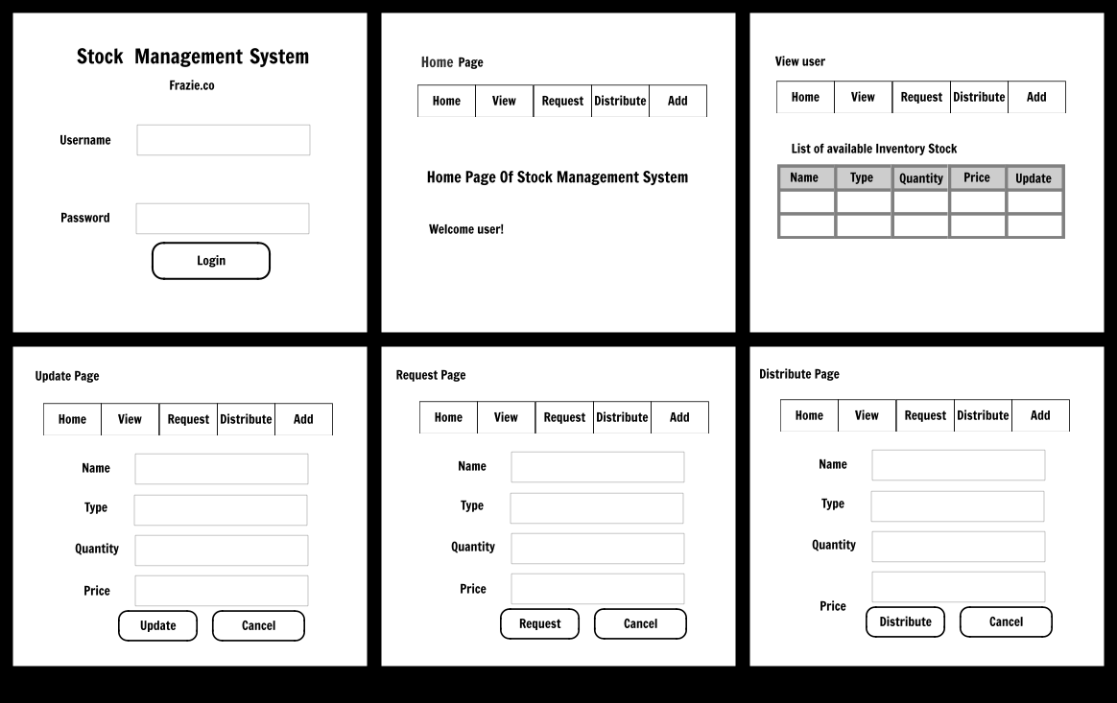

Slide 15
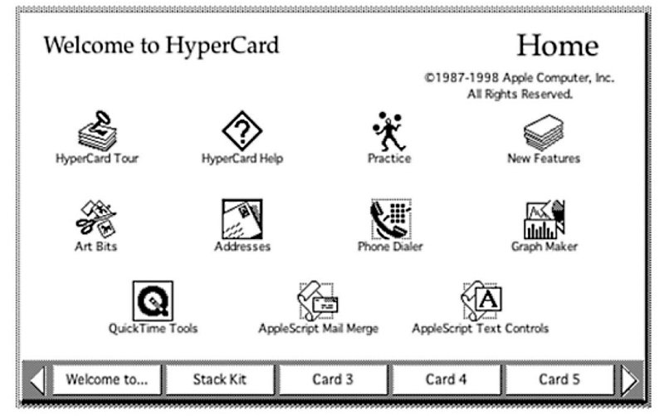

Slide 16
Design rationale
Design rationale is information that explains why a computer system is the way it is.
Benefits of design rationale
  communication throughout life cycle
  reuse of design knowledge across products
  enforces design discipline
  presents arguments for design trade-offs
  organizes potentially large design space
  capturing contextual information

Slide 17
Design rationale (cont’d)
Types of DR:
Process-oriented
  preserves order of deliberation and decision-making
Structure-oriented
  emphasizes post hoc structuring of considered design alternatives
Two examples:
  Issue-based information system (IBIS)
  Design space analysis

Slide 18
Issue-based information system (IBIS)
basis for much of design rationale research
process-oriented
main elements:
  issues
    – hierarchical structure with one ‘root’ issue
  positions
    – potential resolutions of an issue
  arguments
    – modify the relationship between positions and issues
gIBIS is a graphical version

Slide 19
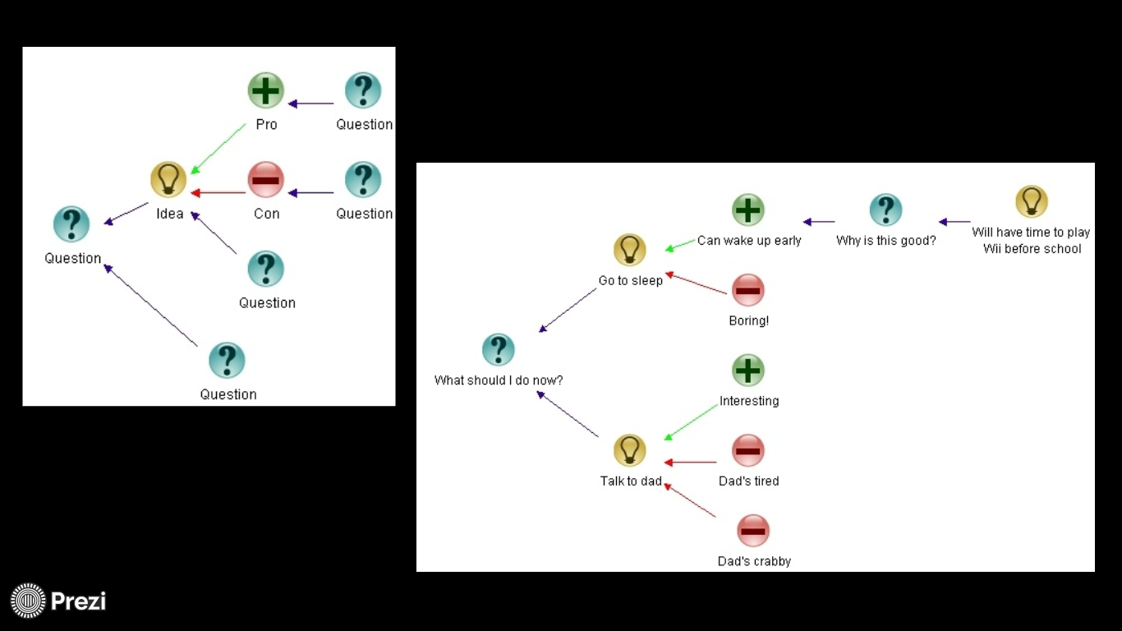

Slide 20
structure of gIBIS
supports
Position
Argument
responds to
Issue
responds to
Position
objects to
Argument
specializes
Sub-issue
generalizes
questions
Sub-issue
Sub-issue

Slide 21
Design space analysis
structure-oriented
QOC – hierarchical structure:
  questions (and sub-questions)
    – represent major issues of a design
  options
– provide alternative solutions to the question
  criteria
– the means to assess the options in order to make a choice
DRL – similar to QOC with a larger language and more formal semantics

Slide 22
the QOC notation
Criterion
Option
Question
Option
Criterion
Option
Criterion
…
Consequent
Question
…
Question

Slide 23
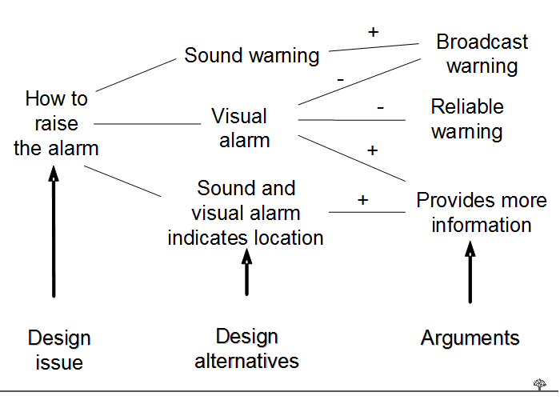

Slide 24
Psychological design rationale
to support task-artefact cycle in which user tasks are affected by the systems they use
aims to make explicit consequences of design for users
designers identify tasks system will support
scenarios are suggested to test task
users are observed on system
psychological claims of system made explicit
negative aspects of design can be used to improve next iteration of design

Slide 25
Summary
The software engineering life cycle
  distinct activities and the consequences for interactive system design
Usability engineering
  making usability measurements explicit as requirements
Iterative design and prototyping
  limited functionality simulations and animations
Design rationale
  recording design knowledge
  process vs. structure

Slide 26
Step 1: Select Your User (Discover)
Step 2: Prepare for & Conduct Interview (Discover) (20-25 minutes)
Step 3: Select Specific Problem (Focus) (10-15 minutes)
Step 4: Generate & Evaluate Ideas (Imagine) (20 minutes)
Step 5: Prototype Your Solution (Prototype) (10-15 minutes)
Step 6: Get User Feedback & Iterate (Try) (15-20 minutes)

Slide 27
General information about your user.
Your interview questions, notes and key takeaways
User problem, expressed concisely
Images and description of your brainstorming process and the solution idea you selected
Your original prototype and description of additional iterations
Your feedback session questions, notes, key takeaways and reflections on ways to iterate your prototype
Your reflections on the design thinking process

